Slide 1
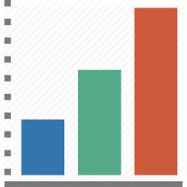

















Predictive analysis using DocumentDB, Machine Learning and Power BI
SCENARIO 5
Modernizing cloud-based web apps
Bulk Data Imported In Json Format
(Past history + weather API)
Data
Azure Functions
Display Statistical Analysis on App
CosmosDB (DocumentDB)
Machine Learning
Predictive Analysis
ContosoAir APP
App Service
Notes:
These data warehouses also struggle to manage a variety of data types, including complex non-relational data which may not be conducive to conventional table storage.

